Slide 1

ZOLLARS – BEGINNERS GUIDE
By:
Surya Narayanan CS
Harshitaa MS
Yazhini S
Notes:
1. Table of contents
2. Introduction
3. Our company
4. Our team
5. Problem
6. Them vs. us
7. Solution
8. SWOT analysis
9. Product overview
10. Our plans
11. Product demo
12. Traction
13. Case study
14. Reviews
15. Awards
16. Market size
17. Target
18. Competitors
19. Business model
20. Timing
21. Predicted growth
22. Investment

Slide 2
Them vs. Us
Them
Us
Technical Trading been increasingly taking over as an alternative for trading money. People tend to lose their asset due to lack of knowledge in cryptocurrency.
Our model is efficient such that it is built in AI where the user finds satisfactory results with more features.

Slide 3
Table of Contents
01
02
03
04
KEY GOAL
Predicting Model
decision-makers who need speedy access to pinpointed information.
Using ARIMA model forecasting to predict the Price of crypto.
Requirements/Resources
DeFi Market
Metis, Python, React, DHV, Supra.
[after starting the project in the hackathon]
Decentralized finance (DeFi) is an emerging financial technology based on secure distributed ledgers similar to those used by cryptocurrencies.

Slide 4

Introduction
The main technology that lies behind our solution is AI. When a question is presented a series or complex algorithms process the received input, understand what the user is asking, and based on that predicts when to buy and resell shares.

Slide 5

Website Architecture
Our website architecture consists of the following made basically for a beginners
1. Bot
2. Customer care
3. Demo account with Bot
4. Instant popups
5. Instant notification
6. DeFi Token

Slide 6
Website Architecture
BOT
Our assistant is designed in such a way to provide wider solutions to buy and resell shares at that instant of time. You don't have to stress about the decisions, and the information is trustworthy
Higher support
Better guidance
Proactively greeting people
Care
Popup
Need not to check every time for the price. Will be alerted every drop and bumps

Slide 7
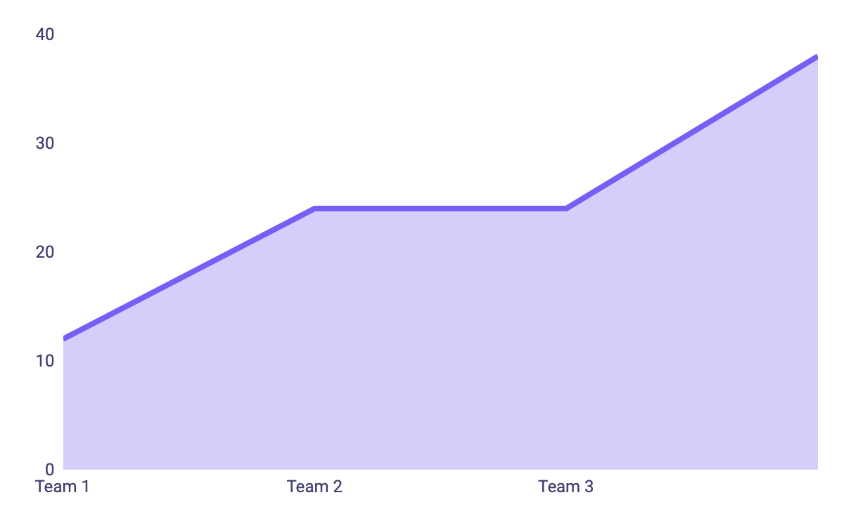
Our Prediction Model
100
50
For this model, we are going to use the ARIMAX model to predict XEM future price. Just like ARIMA model, ARIMAX produces forecasts based on autoregressive (AR) and moving average (MA) terms. ARIMAX includes exogenous variables in the model as well. Machine Learning can most definitely be used as a support in crypto investing, and as a predictor of the price of cryptocurrencies.
25
00
2021
2022
2023
2024

Slide 8
DEFI MARKET
Decentralized finance (DeFi) is an emerging financial technology based on secure distributed ledgers similar to those used by cryptocurrencies. It eliminates the fees that banks and other financial companies charge for using their services.

Slide 9
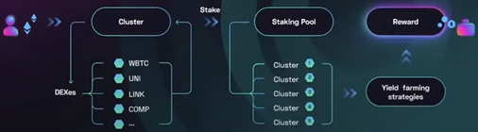
DeHive
First DeFi protocol that helps you to gain maximum profit from the entire DeFi Market while holding just one token
DeHive Cluster – Yeild Generating Index
How it Works

Slide 10
Conclusion
We are looking forward to start this project in this hackathon.
Our instant process makes the user happy and improves satisfaction. The future of technical trading attains it's peak So we provide better solution and guidance specifically for beginners.

